Slide 1

City of Enumclaw Shoreline Master Program Periodic Update - 2019
Planning Commission
February 28, 2019

Slide 2
What is a Shoreline Master Program (SMP)?
The SMP is a set of policies and regulations required by state law. It has three basic principles:
Protect the environmental resources of state shorelines
Promote public access and enjoyment opportunities
Give priority to water dependent uses that require a shoreline location
The City comprehensively updated its SMP in 2012

Slide 3
Where does the SMP apply?
“Shorelines of the State:” waterbodies that meet certain criteria
In Enumclaw this includes:
Streams with a mean annual flow > 20 cubic feet per second:
Boise Creek and Newaukum Creek
Also includes land within 200 feet of these waterbodies, as well as any associated wetlands and floodplain

Slide 4
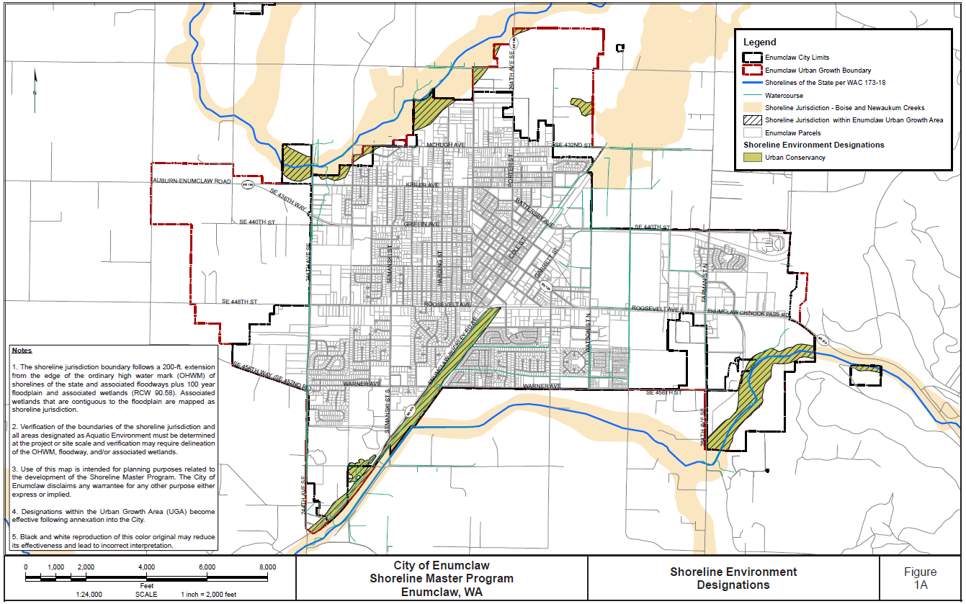

Slide 5
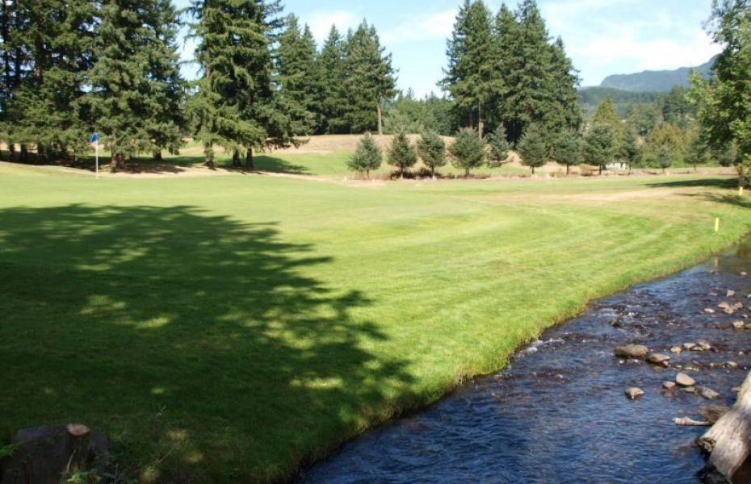
What is the SMP periodic update?
The state requires all SMPs to be reviewed every eight years
Periodic review is intended to keep SMPs current with:
Amendments to state laws
Changes in local plans and regulations
New or improved data and information

Slide 6
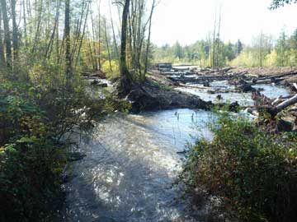
The SMP periodic update will not:
Re-evaluate the ecological baseline which was established as part of the 2012 comprehensive SMP Update
Extensively assess no net loss criteria other than to ensure that proposed amendments do not result in degradation of the baseline condition
Change shoreline jurisdiction or environment designations

Slide 7
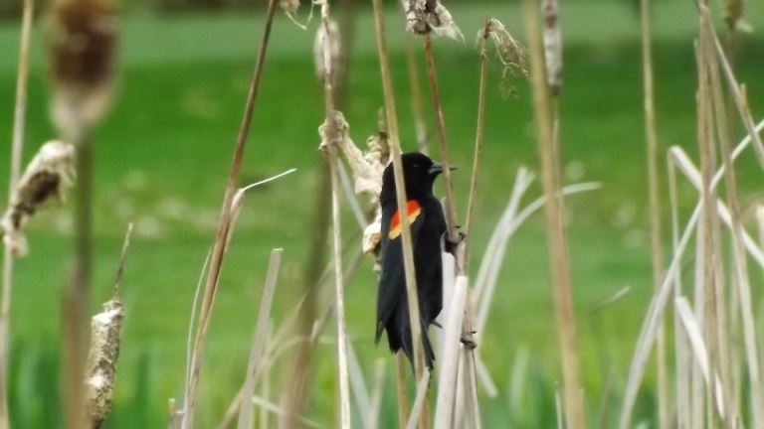
Tentative Schedule:
March 25 Draft SMP Amendments and Gap Analysis Report posted on website
April 10-May 10 Joint Comment period for Ecology and Public
April 25 Community Open House (6-7 PM) and Joint City and Ecology Public Hearing
May-June Ecology review and SMP Amendment revision based upon their comments
July 8 City Council Public Hearing – first reading
July 22 City Council adopts SMP plan and Ordinance

Slide 8
Additional information:
Project website:
http://www.cityofenumclaw.net/221/Shoreline-Master-Program-Update
Staff contact is Chris Pasinetti, Planning Director
(360) 615-5726
e-mail: CPasinetti@ci.enumclaw.wa.us

Slide 9
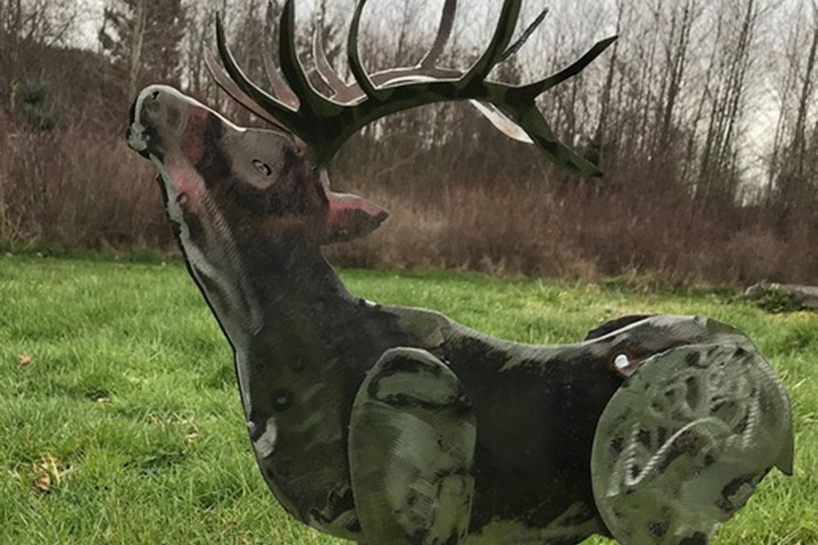
Questions and Comments

